Slide 1
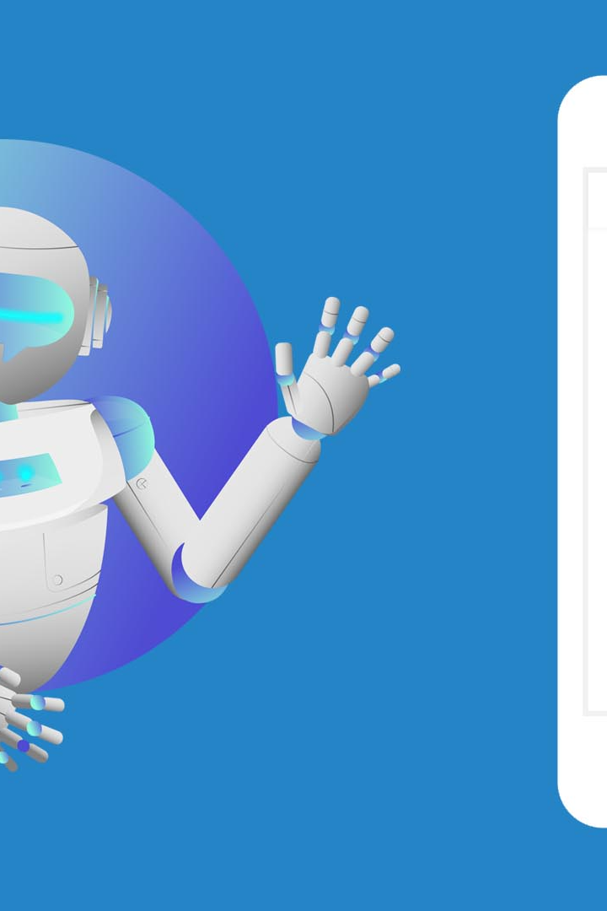

Chatbot for Telegram
chatbot are essential as they can give a reply to same occurring problems
so we have design a chatbot where where you could get the appropriate solution of your problems.

Slide 2
Problem we face
1
1) sometimes the chatbot doesn't respond correctly.
2
2) sometimes the chatbot doesn't reply fast
3
3) chatbot doesn't work when there is more traffic in website

Slide 3

How we solve the problem
1
our chatbot will run even if there is a ton of traffic
2
our chatbot will give appropriate answers
3
our chatbot is time efficient it will give reply within seconds

Slide 4
Application of our chatbot
1
we could have relevant conversation
It could help to target a specific audience
2
3
It is cost efficient and could give app the information which they need to understand their audience

Slide 6
Future Trends and Developments in Telegram Chatbots
1
Advanced Natural Language Processing
2
AI-Powered Chatbots
Explore the integration of artificial intelligence to create smarter and more intuitive chatbot experiences.
Discover how chatbots are becoming more sophisticated in understanding and responding to natural language.

Slide 7
Conclusion
Recap of Benefits and Capabilities
Importance of Chatbots in Telegram's Ecosystem
Summarize the advantages and capabilities of using chatbots in Telegram.
Highlight the significance of chatbots in shaping the future of communication and engagement on Telegram.

